Slide 1
WELCOME BACK!
Good morning! We missed you!
Make a name tent (back table)
Grab a red and a blue sticky note
Re-start your stopped EC2 instance, copy new public DNS
Connect to the instance (hint - use ‘ssh’)
Think about writing a blog post, and check out Mark’s microbial analysis haikus on twitter.
Get ready to QIIME it up!

Slide 2
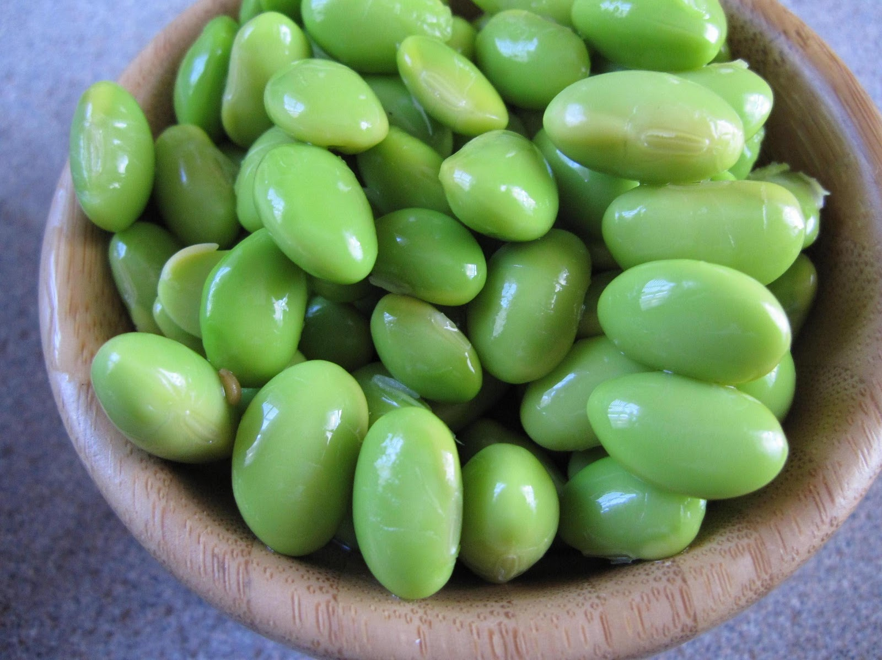
Explorations in Data Analyses for Metagenomic Advances in Microbial Ecology
20 June – 01 July 2015
Kellogg Biological Station
Michigan State University

Slide 3
Conceptual Review
Microbial communities are local assemblages of microorganisms that interact with each other or with their environment
“OTUs” – operational taxonomic units – as a microbial species definition (97% identity 16S rRNA)
There are lots of choices for analyzing high-throughput sequencing data – choice of seq. platform, primers, variable region; depth of sampling; analysis methods – most of these can be reasonably informed by the community of interest, the scientific question, and the experiment design

Slide 4
Practical Review - yesterday
Navigating in the Shell
Starting an EC2 instance
Connecting to the instance and transferring files
Installing software on an instance
Using FastQC to assess raw Illumina quality

Slide 5
Questions from yesterday?
?

Slide 6
Ju and Zhang 2015 Applied Microbiology Technology

Slide 7
Intro to amplicon sequence analysis
Merging paired-end Illumina Reads – pandaseq
QIIME:
Clustering sequences by 97% identity
Picking representative sequences
assigning taxonomy to sequences
Building and alignment and phylogenetic tree
Building an “even” OTU table : equal No. sequences per sample so that comparisons can be made
Calculating within-sample (alpha) diversity

Slide 8
What does a community look like, data-style?
“OTU table” – the original
.Biom table – more concise & faster computing for extra large datasets
Newer formats : “biom2”
See McDonald et al. 2012. “The Biological Observation Matrix…” GigaScience.

Slide 9
Kinds of Community matrix/ OTU Table
 | Soil 1 | Soil 2 | Soil 3
OTU 1 | 0 | 3000 | 23
OTU 2 | 1 | 5 | 5
OTU 3 | 20 | 100 | 100
Raw
Straight up counts*
*note: data must be subsampled to an even sequencing effort!
 | Soil 1 | Soil 2 | Soil 3
OTU 1 | 0 | 0.966 | 0.179
OTU 2 | 0.047 | 0.002 | 0.039
OTU 3 | 0.953 | 0.032 | 0.782
Relative
Percent or proportion
 | Soil 1 | Soil 2 | Soil 3
OTU 1 | 0 | 1 | 1
OTU 2 | 1 | 1 | 1
OTU 3 | 1 | 1 | 1
Binary
Presence/absence

Slide 10
Information in an OTU table
Number of occurrences (per sample and for the whole dataset)
Total no. OTUs observed in the dataset
Average abundance of OTUs
Richness (no. OTUs per sample, mean, max, min, range)
Number of singletons (OTUs detected only once in a dataset)
Calculate: Diversity, Evenness (equitability of OTU abundances, including rarity and dominance)
Number of samples (communities) in your dataset
Dimensions of an OTU table: rows (taxa) x columns (samples/communities)

Slide 11
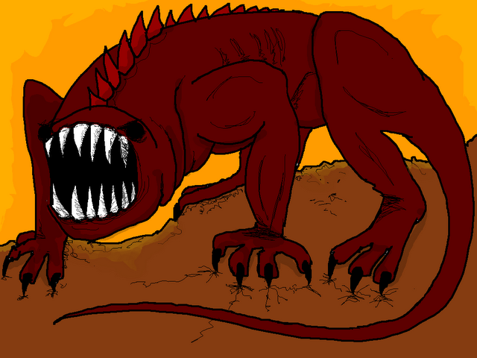
Common features of microbial OTU tables
Redundant: more than one taxa has the exact same pattern
Unknown underlying distribution
Contain many “zeros”
Many samples and OTUs; computationally large
(A beast, hyperboleandahalf.blogspot.com)

Slide 12
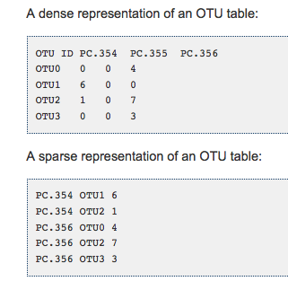
Biom formatted OTU tables
.biom format
Link:
http://biom-format.org
This is all changing very often!! Biom formats are constantly improved, keep up with when changes are anticipated
Traditional OTU table - microbial communities have lots of 0’s
.biom formatted – only list present taxa

Slide 13
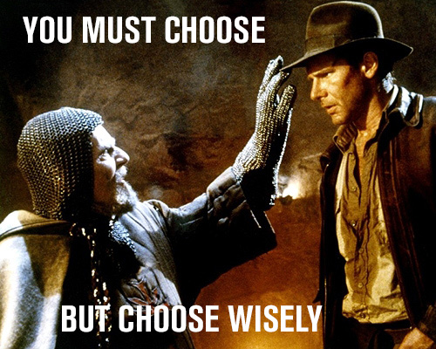
Naming Conventions
Examples of a a good name
20_A_T1_R1 (translation : subject 20, treatment A, timepoint 1, rep1 )
Examples : Bad name
Ashley’s sample
A
Ashley Loves Microbes Pool #1!
Example : kind of bad names
ALS1, ALS2, ALS3….ALS10, ALS11
Improved:
ALS01, ALS02, ALS03…ALS10, ALS11

Slide 14
Our samples, e.g.
C01_05102014_R1_D01
C01 – Centralia core site 1
Date 05102014 – 05 Oct 2014
R1 – core 1 (there were sometimes multiple cores from the same site)
D01 – DNA extraction replicate 1 D01- DNA extraction rep 1
…
F – forward read; R = Reverse read

Slide 15
Approaches to Picking OTUs
Reference based : percent identity to defined taxa populating in a reference database
Pros: you know the taxa are “real”!
Cons: Weird environments don’t have many representatives in databases, only as good as your database
De novo : percent identity to other sequences in the dataset; taxonomic assignment to the OTUs happens afterwards
Pros: Good for weird environments with low representation in databases
Cons: Computationally expensive, “greedy” algorithms can artificially inflate diversity
Open reference : cluster against a reference db first, and anything that doesn’t hit gets clustered de novo
Best of both worlds? Now can optimized so that new de novo OTUs are added to the original database and used subsequently in “reference” clustering
See Rideout et al. 2014 PeerJ

Slide 16
A look at python syntax & common arguments in QIIME
Python script
Input file
filter_fasta.py -f rep_set_aligned.fasta -o non_chimeric_rep_set_aligned.fasta -s chimeric_seqs.txt -n
Output file
Other arguments, specific to the script
Other common QIIME arguments
-m analysis method, metric (sometimes map file)
-t tree file
-a alignment template file
-v verbose = good for troubleshooting
-h help
-f force overwrite of an existing directory

Slide 17
Tutorial: What we’re about to do
Practice subsampling a dataset to make it managable for workflow development
Merge paired end reads with PANDASeq; move the sequences into QIIME
Pick OTUs open reference - includes:
Quality control/ chimera check
Cluster at 97% identity
Pick representative sequence for the whole OTU
Assign taxonomy to the rep. sequence
Make an alignment of the rep. sequence
Build a tree from the alignment
Made OTU tables (biom + classic): make_otu_table.py
Rarefy to an equal sequencing depth
Calculated & visualized alpha diversity

Slide 18
Let’s analysis!

Slide 19
Analysis is hard, and it is completely normal to struggle.
☺
☹
Workflow diagram
Pace – just fine
Like details of all the flags/options
Directory angst – where am I?
Why aren’t tutorials perfect? – too many changes
Where do we modify the pipeline for our own datasets?
Pace – too fast

Slide 20
Diversity part 1
What is diversity anyway?
The advantage of phylogenetic information
Rarefaction
What does a community look like, data-style?
A note on the .biom v. OTU table format
A note on naming conventions
Intro to python scripting

Slide 21
Diversity in all of its glory
“Diversity” is a vague word. In ecology, it has there are many types of diversity (e.g., alpha, beta, gamma), and there are many components to that contribute to those types.
Alpha diversity refers to the diversity inherently descriptive of one sample.

Slide 22
Whittaker introduces alpha, beta, gamma diversity (1972)

Slide 23
The confusion continues… for decades
Ecology Letters 2011
Oecologia 2010

Slide 24
Within-sample (aka alpha) diversity
Within-sample diversity includes:
Richness (number of taxa)
Evenness (distribution of the abundances of taxa)
Phylogenetic diversity (breadth of phylogenetic representation)
*Composition (who’s there – identity of the taxa)
Combinations of the above components are used to calculate other diversities: Shannon diversity, Simpson, etc.

Slide 25
Within-sample diversity
Information about the community that we can glean from metagenomic sequencing
A certain number of OTUs- richness
Each OTU is present in a certain abundance- collectively, evenness
Each OTU has a taxonomic assignment- composition
Phylogenetic breadth - how related are the lineages represented in the community?
C₆H₁₂O₆
CH₄
CO₂
CO₂
C₂H₃O₂⁻
Acyl-HSL
O₂
HPO₄²⁻
NH₄⁺
H₂
NO₃⁻
N₂
MeS
SO₄²⁻
HS⁻
Me²⁺

Slide 26
Richness
Richness: How many OTUs?
OTU
Richness = 11 OTUs

Slide 27
Evenness
Evenness: What is the distribution of abundances in the community?
OTU
Count:
No. seq, no. individuals (e.g., FISH), biomass, etc.
6
1
4
8
1
5
3
13
5
1
2

Slide 28
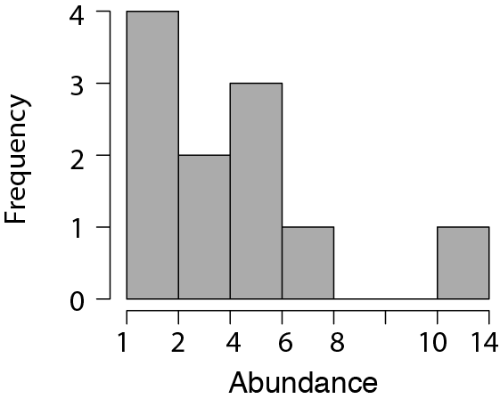
Evenness
Evenness: What is the distribution of abundances in the community?
OTU
Count:
13
8
6
5
5
4
3
2
1
1
1

Slide 29
Membership and Composition
Composition: Who is there?
OTU
Count:
13 Alpha-proteobacteria
8 Firmicutes
6 Beta-proteobacteria
5 Bacteroidetes
5 Actinobacteria
4 TM7
3 Alpha-proteobacteria
2 Gamma-protobacteria
1 Bacteroidetes
1 Bacteroidetes
1 Verrucomicrobia

Slide 30
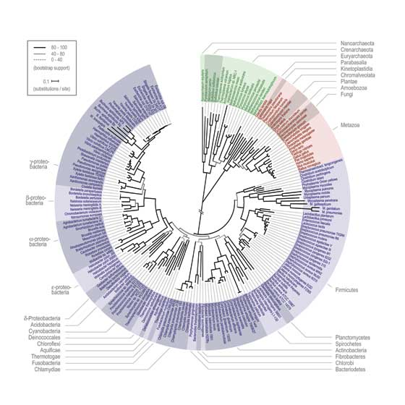
The advantages of phylogeny
Phylogenetic diversity: What is the breadth of phylogenetic representation?
OTU
Count:
Common metric =
Faith’s phylogenetic diversity
13 Alpha-proteobacteria
8 Firmicutes
6 Beta-proteobacteria
5 Bacteroidetes
5 Actinobacteria
4 TM7
3 Alpha-proteobacteria
2 Gamma-protobacteria
1 Bacteroidetes
1 Bacteroidetes
1 Verrucomicrobia

Slide 31
Subsampling: Get “even”
Because of sequencing artifacts and experimental design, there can be quite a range of quality sequences returned for each sample.
Sub-sampling of sequences to achieve an even number across all samples within a dataset allows for comparing diversity across samples
This is very important for being able to compare diversity across samples.
Analogy: You are a tree ecologist. Would it be reasonable to directly compare the forest diversity (assessed by counting different types of trees) in a 1x1 m plot to a 1000 x 1000 km plot? The second plot has 1000x the coverage as the first and thus the comparison is unsound.
Choose a sequencing depth that maximizes the number of samples that can be included at the most informative sequencing depth.
If you have obvious outliers in sequencing depth (e.g., the median depth is 70K and you have one sample with 1000 sequences), get rid of it and save yourself heartache.

Slide 32
Let’s analysis!

Slide 33
Diversity Part 2

Slide 34
Diversity Part 1 Review
Within-sample diversity describes a single community/ sample, and includes metrics of richness, evenness, phylogenetic diversity, and other summative metrics of diversity.
Because sequencing success can be highly variable, rarefaction is used to ensure an even-depth of sequences across communities that will be compared.
An OTU table is the input file for community analyses. It contains information about the abundance of each OTU within every sample. OTU tables can be (classic, .txt) or (.biom) format.

Slide 35
Tutorial: What we’re about to do
Rarefied to an equal sequencing depth: alpha_rarefaction.py
Calculated & visualized alpha diversity: alpha_diversity.py, summarize_taxa_through_plots.py

Slide 36
Questions?
?

Slide 37
Amplicon sequence analysis continued
In QIIME:
Calculating comparative (beta) diversity
Visualizing patterns of comparative diversity
Hypothesis testing: clusters and gradients
Dealing with the QIIME biom table: conversion and nuances

Slide 38
Outline: Comparative (beta) diversity
What questions can you ask about your microbial communities?
Comparative diversity
Calculating community resemblance
Visualizations: Ordinations, heatmaps, dendrograms
Gradients versus categories (clusters)
Statistical analysis of clusters: Hypothesis testing for differences in categorical groups
Statistical analysis of gradients: Linking environmental variables to changes in community structure

Slide 39
Questions about microbial communities
Summary information for each community: Within-sample (alpha) diversity
Differences between communities: Comparative (beta) diversity

Slide 40
Ask yourself: What is the purpose of the analysis?
Exploration: hypothesis generating, perfect for observational studies, includes visualizations like ordinations and clustering
Hypothesis testing: address a specific question (e.g., are there differences among treatment groups?), and usually permutation-based (non-parametric) p-value

Slide 41
What questions do you want to ask about your microbial communities?

Slide 42
Comparative diversity
Space / Time
Categories (e.g., fire-affected, recovered)
Gradients/empirical measurements (e.g., pH, temperature, chemistry)
Look forward to Stuart’s R lecture on category/gradient analyses!

Slide 43
Analysis of comparative diversity is informed by:
Associated environmental/quantitative variables*
Examples: temperature, red blood cell counts, glucose levels, dissolved oxygen, temperature, acidity, time, % mortality, etc.
Associated categorical/descriptive/qualitative variables*
Examples: treatment groups, male/female, control/treatment, age groups, before/after
* Environmental and categorical variables often are linked to samples in a single “mapping file”

Slide 44
Comparative diversity requires a measure of pair-wise community resemblance
Resemblance = distance, similarity, dissimilarity
Important decisions in choosing a resemblance metric:
Weighted v. Unweighted
Phylogenetic v. Taxonomic
All pairs of resemblances are included in a sample by sample resemblance (distance/similarity) matrix
Simplifies the data and the analysis
Choice of resemblance metric will influence the outcome of community analysis

Slide 45
Calculating resemblance: Bray-Curtis Example
d_{jk} = (sum abs(x_{ij}-x_{ik})/(sum (x_{ij}+x_{ik}))
Where d_{jk} is the Bray-Curtis index between samples j and k
and x is the (relative) abundance of taxa I
See Legendre and Legendre book: Numerical Ecology. Chapter 7: “Ecological resemblance” for a comprehensive discussion of All the Resemblances Ever.

Slide 46
Making a Resemblance Matrix
1. OTU table (usually relativized)
 | Soil 1 | Soil 2 | Soil 3
OTU 1 | 0 | 0.966 | 0.179
OTU 3 | 0.047 | 0.002 | 0.039
OTU 3 | 0.953 | 0.032 | 0.782
2. Chose appropriate resemblance (e.g., Bray Curtis, UniFrac)
 | Soil 1 | Soil 2 | Soil 3
Soil 1 | 0
Soil 2 | 0.966 | 0
Soil 3 | 0.179 | 0.787 | 0
3. Create a square (observation x observation) resemblance matrix from pair-wise comparisons.
Notes:
The purpose of a resemblence matrix is to reduce complexity in the dataset so that it can be used for hypothesis testing or exploration analyses

Slide 47
Examples of Resemblance metrics
Weighted metrics
Unweighted metrics
Phylogenetic metrics
Taxonomic metrics
Metric name Accounts for | Sørensen | Bray-Curtis | Weighted UniFrac | Unweighted UniFrac
Composition | X | X | X | X
OTU abundances? |  | X | X
Phylogenetic diversity? |  |  | X | X

Slide 48
We can compare different distance/similarity measures to deduce the most important components of community structure for the overarching patterns observed

Slide 49
Useful community visualization tools
Ordination : Calculated from community resemblance; relationships are represented by distances between symbols
Heatmap : Calculated from count/abundance data; The abundance of each taxon relative to the others depicted by color
Dendrogram: Calculated from community resemblance; similar communities fall into same cluster.

Slide 50
Visualizing communities: ordination
Legend
Treatment 1
Control
Axis 2: 6% variance explained
Axis 1: 50% variance explained
2 or 3 dimensional representation of the data
Each symbol is one community (compared by the chosen resemblance metric)
The distance between symbols represents the extent of differences between communities
First axis often explains most variance in the data, variation explained should be provided.

Slide 51
Types of ordinations
Non-metric multidimensional scaling (NMDS)
Principle coordinates analysis (PCoA)
Correspondence analysis (CA)
Avoid: Principle components analysis (PCA), Redundancy analysis (RDA) in some situations, and constrained analyses unless you really know what you are doing

Slide 52
How do we look at ordinations?
Think about: CENTROID (mean) or DISPERSION (spread, variability)
A. Different centroid, same spread
B. Different centroid, different spread
C. Same centroid, different spread

Slide 53
Visualizing communities: dendrograms
A different way of visualizing the same data
=
Legend
0%
Treatment 1
Control
Resemblance
50%
100%
Notes:
Note: cluster is not the same as phylogenetic analysis.

Slide 54
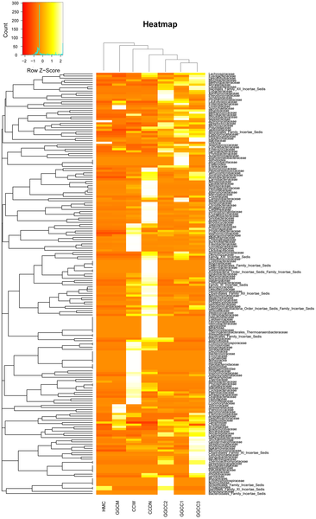

Visualizing communities: heatmaps
Figure 6. Bacterial distribution among the seven samples.
Wu S, Wang G, Angert ER, Wang W, et al. (2012) Composition, Diversity, and Origin of the Bacterial Community in Grass Carp Intestine. PLoS ONE 7(2): e30440. doi:10.1371/journal.pone.0030440
http://www.plosone.org/article/info:doi/10.1371/journal.pone.0030440

Slide 55
Discovering patterns: Clusters & Gradients
Clusters = Are groups different? (e.g., Treatment v. Control)
Also called: factors, qualitative variables
Gradients = Do communities change with known environmental changes? (e.g., over time?)
Also called: continuous, quantitative, vector variables

Slide 56
How do we interpret ordinations?
Think about: CENTROID (mean) or DISPERSION (spread, variability)
A. Different centroid, same spread
B. Different centroid, different spread
C. Same centroid, different spread

Slide 57
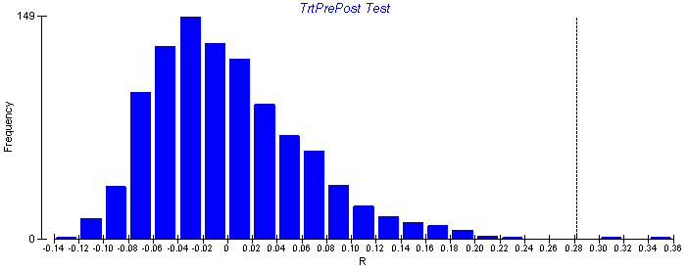
Non-parametric hypothesis tests
Non-parametric tests are used to test hypotheses of multivariate data when the underlying distribution of the data is unknown.
Non-parametric tests randomly re-sample the dataset to create a re-shuffled distribution, calculate a test statistic for each random distribution, and then ask the probably of finding the actual statistic given the random re-sampling distribution of the data.
It is important to use these tests for microbial beta diversity, as the assumptions of underlying normal distributions of most parametric tests (e.g., ANOVA) are violated.

Slide 58
Clusters: Testing for differences in a priori groups
Permutation-based analyses to test hypotheses about group differences in CENTROID (mean) or DISPERSION (spread, variability)
A. Different centroid, same spread
Test name | Centroid (mean) | Spread (variability)
PERMANOVA | X | X
MRPP | X | X
ANOSIM | X | X
PERMDISP |  | X
B. Different centroid, different spread
C. Same centroid, different spread

Slide 59
A paper where every hypothesis test is used with every resemblance. Ever.
(just kidding)
(kind of)
The methods are useful.
Shade et al. 2013 AEM

Slide 60
Gradients: Linking environmental and community data
1. Mantel Test
2. Vector fitting to ordination axis score
Community Resemblance
 | Caterpillar 1 | Caterpillar 2 | Caterpillar 3
Caterpillar 1 | 0
Caterpillar 2 | 0.966 | 0
Caterpillar 3 | 0.179 | 0.787 | 0
Pearson’s correlation
Permuted p value
Axis 2
Time
Time / environ. distance
Temperature
 | Caterpillar 1 | Caterpillar 2 | Caterpillar 3
Caterpillar 1 | 0
Caterpillar 2 | 1 | 0
Caterpillar 3 | 10 | 3 | 0
Axis 1

Slide 61
Practicalities: Getting data into R from QIIME
Biom to classic OTU table
-See end of QIIME 3 tutorial : biom convert
For importing resemblance tables
1. read.table(header=TRUE, row.names =1; sep =“\t”)
2. as.dist()

Slide 62
Let’s analysis!

